Slide 1
Image Compression

Slide 2
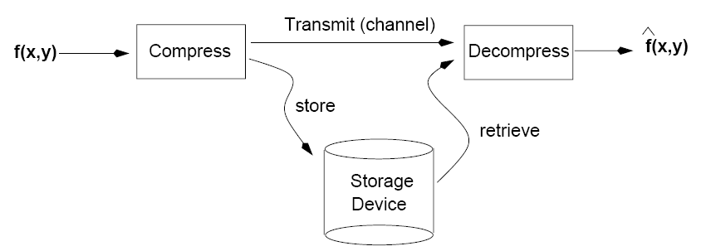
Introduction
The goal of image compression is to reduce the amount of data required to represent a digital image.
  i.e., remove redundant data
Image compression is very important for image storage and image transmission.

Slide 3
Applications
Storage
  Educational and business documents
  Medical images
  Weather maps
  Fingerprints (FBI database)
Transmission
  Remote sensing via satellite
  Military communications via aircraft, radar, and sonar
  Teleconferencing
  Facsimile transmission (FAX)

Slide 4
Compression Rates
Advanced compression techniques can achieve compression ratios in the range 10:1 to 50:1 without visibly affecting image quality.
Very high compression ratios (e.g., 2000:1) can be achieved when compressing video signals.
For practical reasons, compression and decompression should be fast.

Slide 5
Approaches
Lossless
  Information preserving
  Low compression ratios
  e.g., Huffman
Lossy
  Does not preserve information
  High compression ratios
  e.g., JPEG
Tradeoff: image quality vs compression ratio

Slide 6
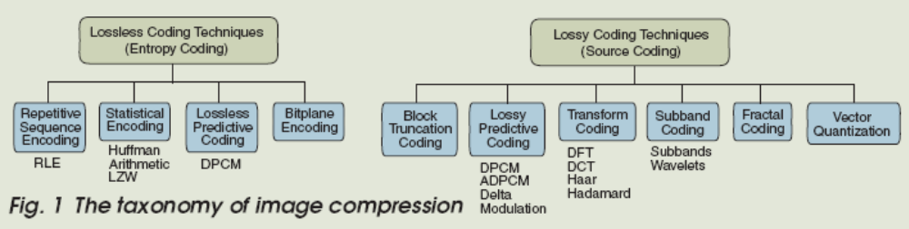
Taxonomy of Image Compression

Slide 7
Data vs Information
Data and information are not synonymous terms!
Data is the means by which information is conveyed.
Data compression aims to reduce the amount of data required to represent a given quantity of information while preserving as much information as possible.

Slide 8
Information vs Data
REDUNDANTDATA
INFORMATION
DATA = INFORMATION + REDUNDANT DATA

Slide 9
Data vs Information (cont’d)
The same amount of information can be represented by various amount of data, e.g.:
Ex1:
Your wife, Helen, will meet you at Logan Airport in Boston at 5 minutes past 6:00 pm tomorrow night
Your wife will meet you at Logan Airport at 5 minutes past 6:00 pm tomorrow night
Helen will meet you at Logan at 6:00 pm tomorrow night
Ex2:
Ex3:

Slide 10
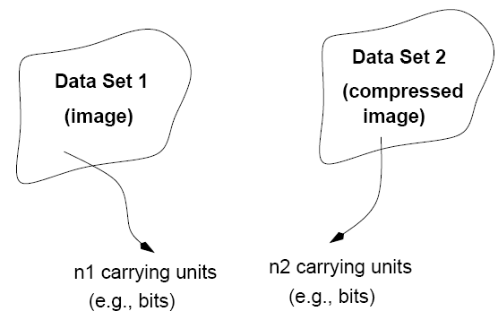
Data Redundancy
Data redundancy is a mathematically quantifiable entity!

Slide 11
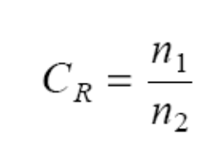
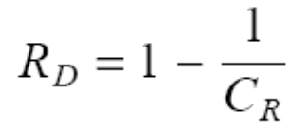
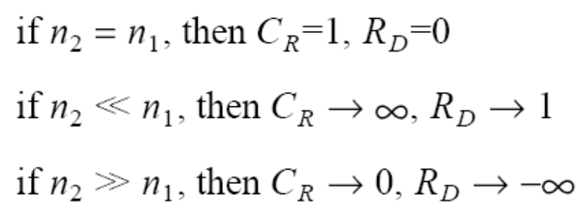
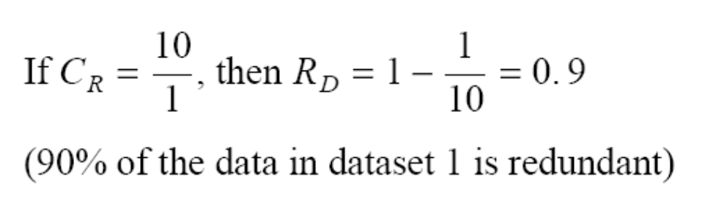
Data Redundancy (cont’d)
Compression ratio:
Relative data redundancy:
Example:

Slide 12
Types of Data Redundancy
Coding redundancy
Spatial and temporal redundancy
Irrelevant information (Psycho-visual redundancy)
The role of compression is to reduce one or more of these redundancy types.

Slide 13
How can we implement compression?
Coding redundancy
Most 2-D intensity arrays contain more bits than are needed to represent the intensities
Spatial and temporal redundancy
Pixels of most 2-D intensity arrays are correlated spatially and video sequences are temporally correlated
Irrelevant information
Most 2-D intensity arrays contain information that is ignored by the human visual system

Slide 14

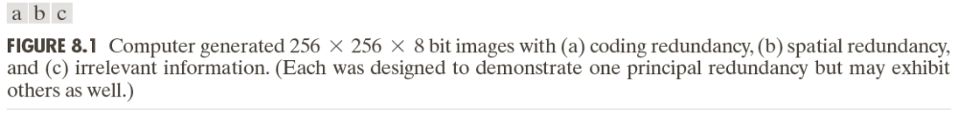
Examples of Redundancy

Slide 15
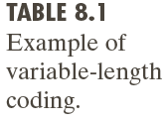
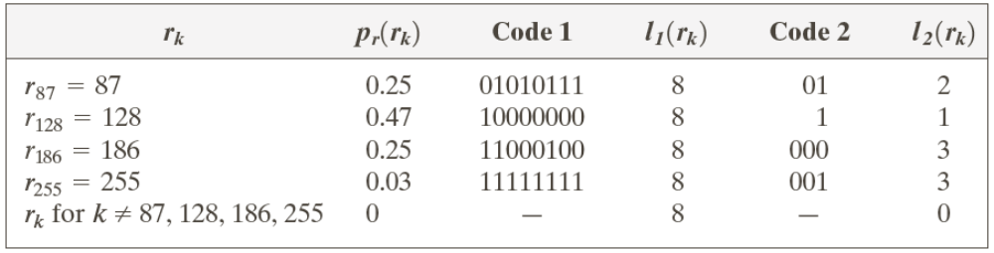
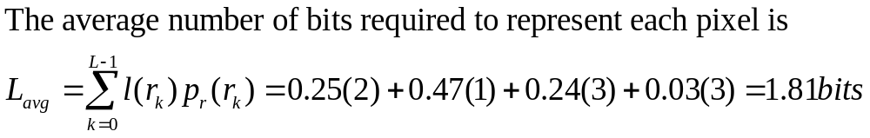
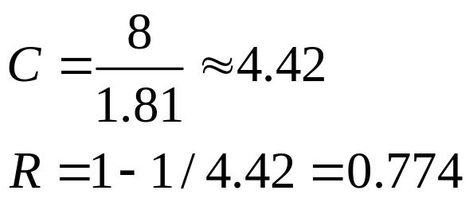
Coding Redundancy

Slide 16
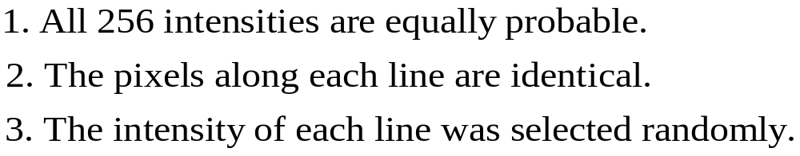
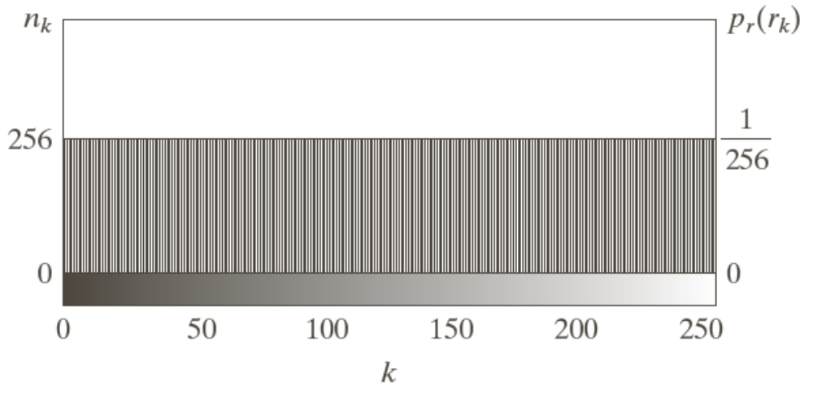
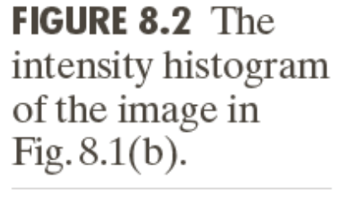
Spatial and Temporal Redundancy

Slide 17
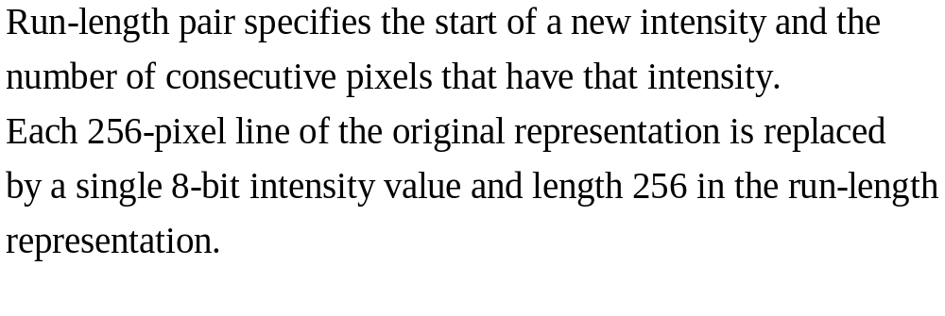
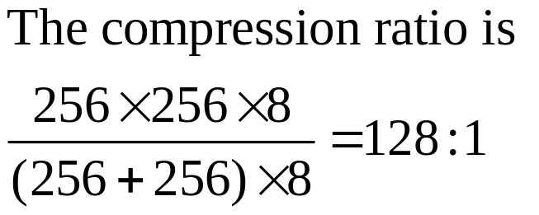
Spatial and Temporal Redundancy

Slide 18
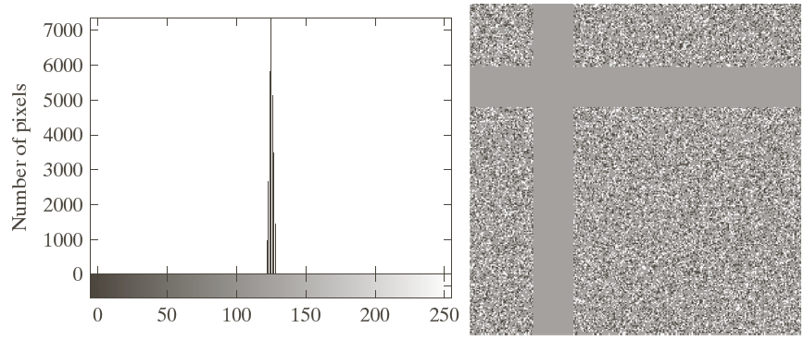
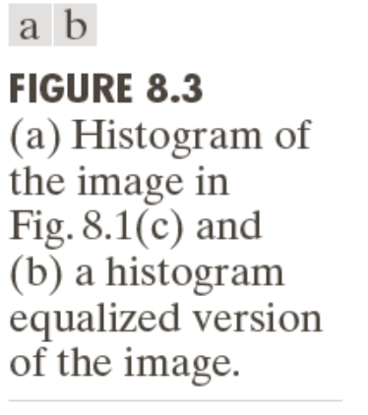
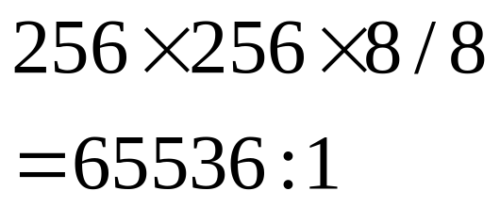
Irrelevant Information

Slide 19
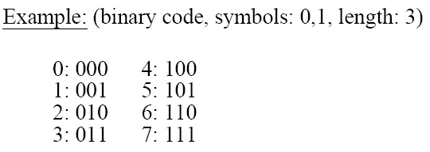
Coding Redundancy
Data compression can be achieved by encoding the data using an appropriate encoding scheme.
Elements of an encoding scheme:
  Code: a list of symbols (letters, numbers, bits etc.)
  Code word: a sequence of symbols used to represent a piece of information or an event (e.g., gray levels)
  Word length: number of symbols in each code word

Slide 20
Avoiding Coding Redundancy
To avoid coding redundancy, codes should be selected according to the probabilities of the events.
Idea: Variable Length Coding
  Assign fewer symbols (bits) to the more probable events (i.e., gray levels in our case)

Slide 21
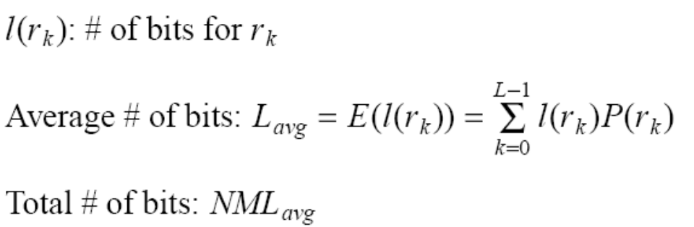
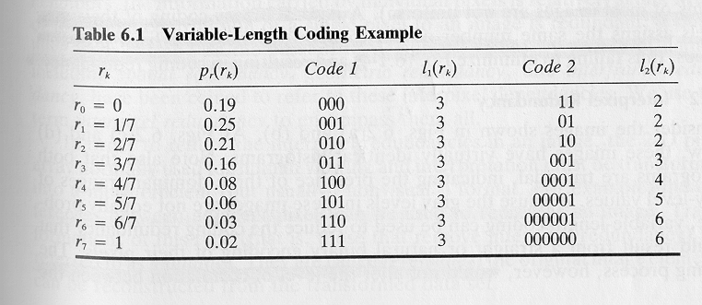
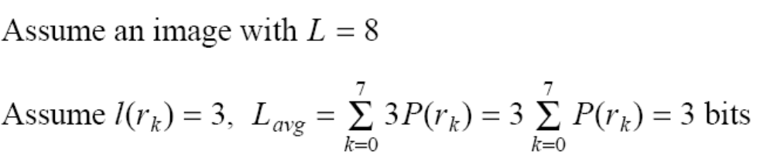

Constant Length Coding
Use the histogram of the image to construct the codes.
Example

Slide 22
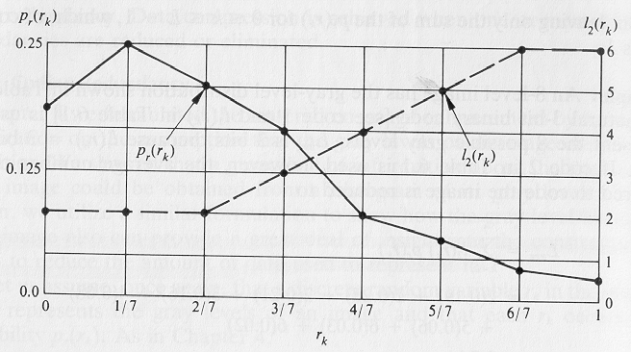
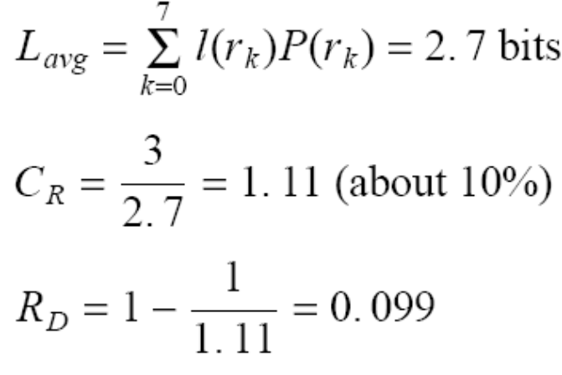
Variable Length Coding
Assume that the probability of the gray levels is considered.
variable length

Slide 23
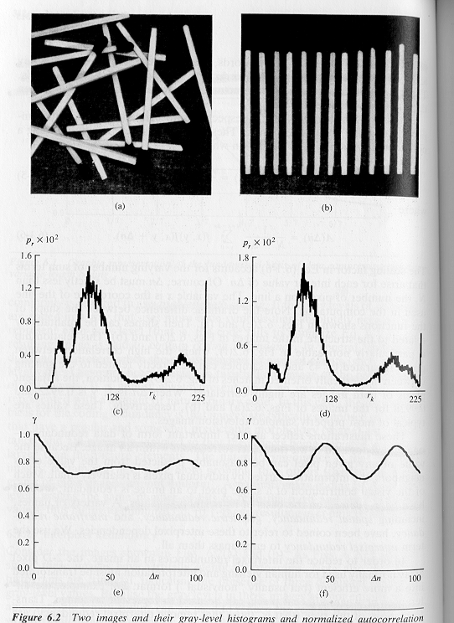
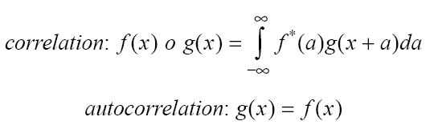
Interpixel redundancy
Interpixel redundancy implies that any pixel value can be reasonably predicted by its neighbors (i.e., correlated).
Structural or geometric relationships between the objects in an image can lead to interpixel redundancy.

Slide 24
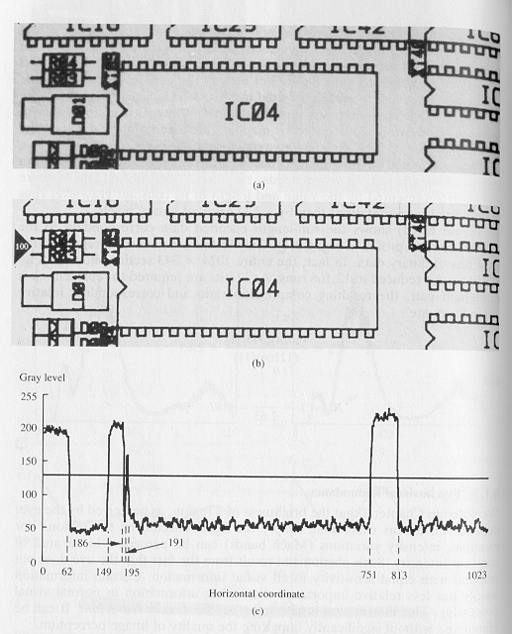
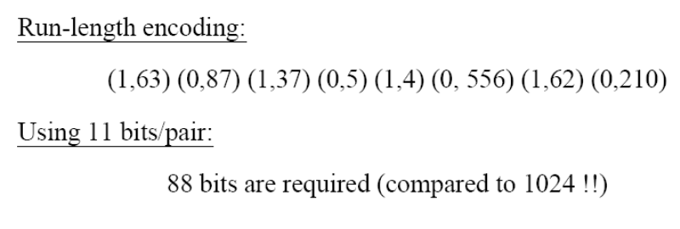
Interpixel redundancy (cont’d)
To reduce interpixel redundnacy, the data must be transformed in another format (i.e., mapping)
  e.g., thresholding, differences between adjacent pixels, DFT
Example:
(profile – line 100)
original
threshold
thresholded
(1+10)

Slide 25
Psychovisual redundancy
Takes into advantage the peculiarities of the human visual system.
The eye does not respond with equal sensitivity to all visual information.
Humans search for important features (e.g., edges, texture, etc.) and do not perform quantitative analysis of every pixel in the image.

Slide 26
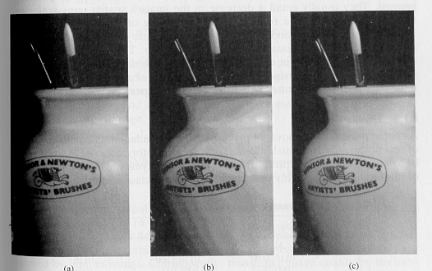
Psychovisual redundancy (cont’d)
Example: Quantization
16 gray levels
improved gray-scale quantization
256 gray levels
16 gray levels
8/4
=
2:1
i.e., add to each pixel a
pseudo-random number
prior to quantization

Slide 27
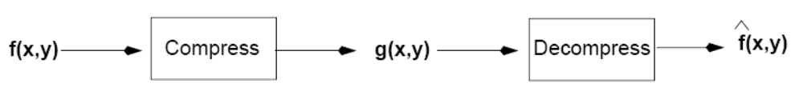
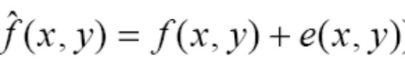


Fidelity Criteria
How close is to ?
Criteria
  Objective: mathematically defined criteria
  Subjective: based on human observers

Slide 28
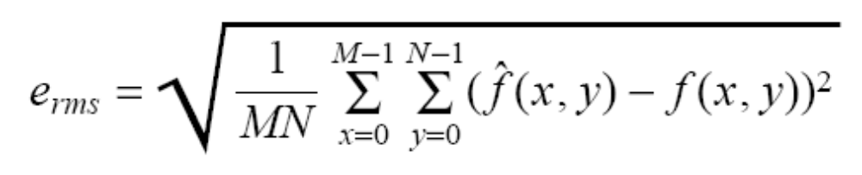
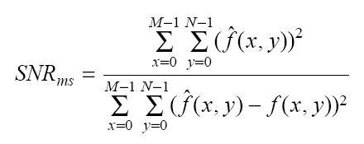
Objective Fidelity Criteria
Root mean square error (rms)
Mean-square signal-to-noise ratio

Slide 29
How do we measure information?
What is the information content of a message/image?
What is the minimum amount of data that is sufficient to describe completely an image without loss of information?

Slide 30
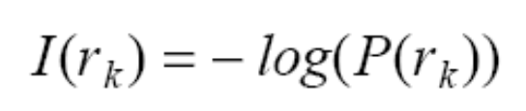
Modeling the Information Generation Process
Assume that the generation of information is a probabilistic process.
A random event E which occurs with probability P(E) contains:
Suppose that the gray level value of pixels is generated by a random variable, then r_{k} contains
units of information

Slide 31
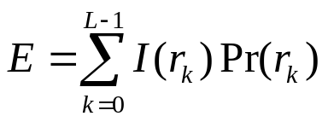
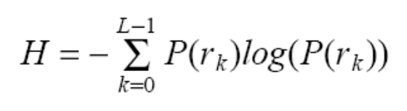

Modeling the information generation process (cont’d)
Entropy: the average information content of an image:
Redundancy:
or
units/pixel
(defined
earlier)

Slide 32
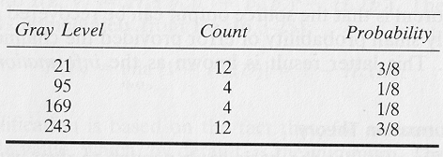
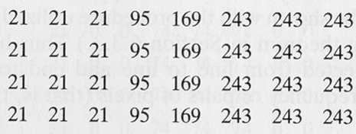
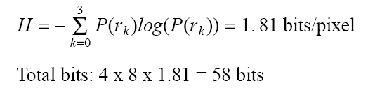
Estimating Entropy
It is not easy to estimate entropy accurately.
First order estimate of H:
image

Slide 33
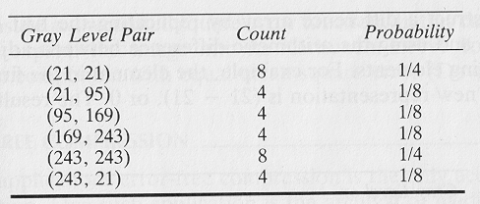
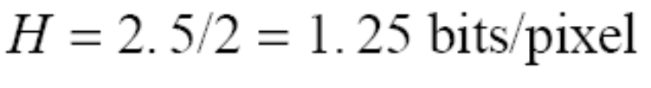
Estimating Entropy (cont’d)
Second order estimate of H:
  Relative frequencies of pixel blocks can be used.

Slide 34
Estimating Entropy (cont’d)
The first-order estimate gives only a lower-bound on the compression that can be achieved.
Differences between higher-order estimates of entropy and the first-order estimate indicate the presence of interpixel redundancies.
Do you remember how do we deal with interpixel redundancy?

Slide 35
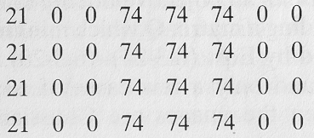
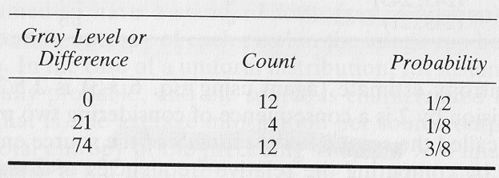
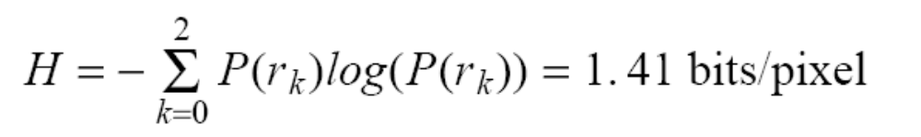
Estimating Entropy (cont’d)
Computing H for difference image can reduce interpixel redundancies:
Better than before, however, a better mapping could be found!

Slide 36
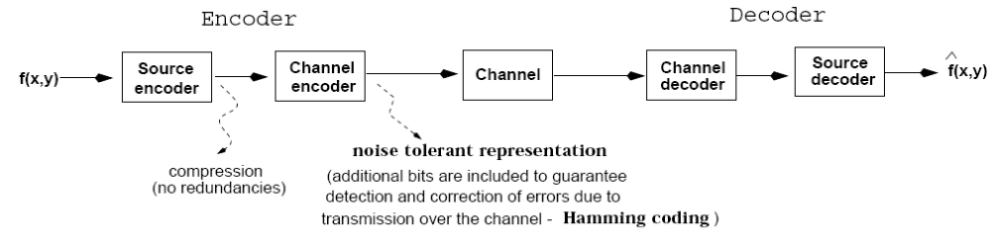
Image Compression Models

Slide 37
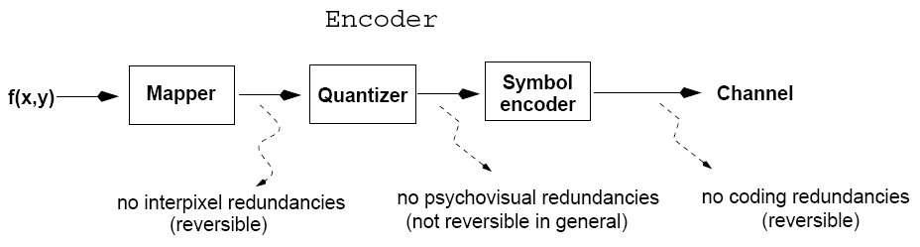
Image Compression Models (cont’d)
Mapper: transforms the input data into a format that facilitates reduction of interpixel redundancies.
Quantizer: reduces the accuracy of the mapper’s output in accordance with some pre-established fidelity criteria.
Symbol encoder: assigns the shortest code to the most frequently occurring output values.

Slide 38
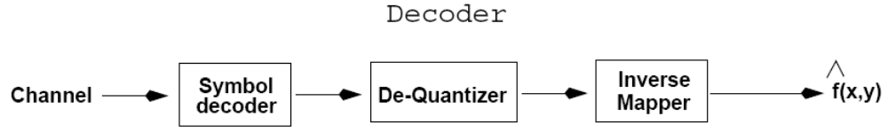
Image Compression Models (cont’d)
The inverse operations are performed.
Quantization is irreversible in general.

Slide 39
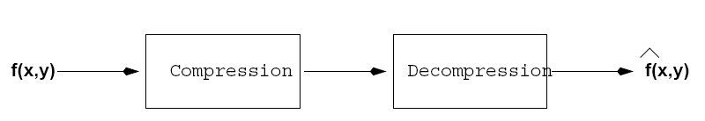

Lossless Compression
We will discuss two different techniques:
  - Huffman encoding
  - Run-length encoding

Slide 40

Huffman Coding
It belongs to the class of variable-length coding techniques.
It creates the optimal code for a set of source symbols.
  Symbols are encoded one at a time

Slide 41

Huffman Coding (cont’d)
Optimal code: minimizes the number of code symbols per source symbol.
  Forward Pass
  1. Sort probabilities per symbol
  2. Combine the lowest two probabilities
  3. Repeat step2 until only two probabilities remain.

Slide 42

Huffman Coding (cont’d)
Backward Pass
  Assign code symbols going backwards

Slide 43


Huffman Coding (cont’d)
What is L_{avg} using Huffman coding?
What is L_{avg} assuming binary codes?

Slide 44

Huffman Coding (cont’d)
Comments
  After the code has been created, coding/decoding can be implemented using a look-up table.
  Decoding can be done in an unambiguous way !!

Slide 45
Run-length coding
Code each contiguous group of 0’s and 1’s, encountered in a left to right scan of a row, by its length.
e.g., (0,1)(1,1)(0,1)(1,0)(0,2)(1,4)(0,2)

Slide 46
LZW (Dictionary coding)
LZW (Lempel-Ziv-Welch) coding, assigns fixed-length code words to variable length sequences of source symbols, but requires no a priori knowledge of the probability of the source symbols.
The n^{th} extension of a source can be coded with fewer average bits per symbol than the original source.
LZW is used in:
Tagged Image file format (TIFF)
Graphic interchange format (GIF)
Portable document format (PDF)
LZW was formulated in 1984

Slide 47
The Algorithm:
A codebook or “dictionary” containing the source symbols is constructed.
For 8-bit monochrome images, the first 256 words of the dictionary are assigned to the gray levels 0-255
Remaining part of the dictionary is filled with sequences of the gray levels

Slide 48
Example:
39 39 126 126
39 39 126 126
39 39 126 126
39 39 126 126

Slide 49


Slide 50
Compression ratio = (8 x 16) / (10 x 9 ) = 64 / 45 = 1.4

Slide 51
Important features of LZW
The dictionary is created while the data are being encoded. So encoding can be done “on the fly”
The dictionary need not be transmitted. Dictionary can be built up at receiving end “on the fly”
If the dictionary “overflows” then we have to reinitialize the dictionary and add a bit to each one of the code words.
Choosing a large dictionary size avoids overflow, but spoils compressions

Slide 52
Decoding LZW:
Let the bit stream received be:
39 126 126 256 258 260 259 257 126
In LZW, the dictionary which was used for encoding need not be sent with the image. A separate dictionary is built by the decoder, on the “fly”, as it reads the received code words.

Slide 53
Recognized | Encoded value | pixels | Dic. address | Dic. entry
 | 39 | 39
39 | 39 | 39 | 256 | 39-39
39 | 126 | 126 | 257 | 39-126
126 | 126 | 126 | 258 | 126-126
126 | 256 | 39-39 | 259 | 126-39
256 | 258 | 126-126 | 260 | 39-39-126
258 | 260 | 39-39-126 | 261 | 126-126-39
260 | 259 | 126-39 | 262 | 39-39-126-126
259 | 257 | 39-126 | 263 | 126-39-39
257 | 126 | 126 | 264 | 39-126-126

